Slide 1
2023/24

Slide 2
Encompasses the PhD students and candidates in the Alberta School of Business
Improve the overall quality and value of the Business PhD experience
Represent the needs of students in the PhD program at the Alberta School of Business
facilitate information-sharing about many facets of PhD student life on campus and in Edmonton

Slide 3
02
01
Marketing
Accounting and Business Analytics
1
2
04
03
3
4
Strategy, Entrepreneurship and Management
Finance

Slide 4
行业PPT模板http://www.1ppt.com/hangye/
2023/24 BDA Executive Members
Co-Presidents
Amirreza Faghihinia (Marketing) and Xin Yang (Accounting)
VP Governance & Finance
Linfeng Tian (Finance)
VP Communications & Operations
Shuhan Yang (Marketing)
VP Advocacy
Mehri Baloochi (SEM)
VP Careers
Samira Jafari (SEM)
VP Community Building
Soroush Sadeghi (OIS)

Slide 5
Our Mission
Promote involvement and social interaction within the Business PhD student body
Encourage and celebrate our diverse student population

Slide 6
Our Mission
Foster strong relationships between PhD students and faculty
Promote and support the welfare of PhD students

Slide 7
Our Mission
Facilitate positive relationships within the PhD student group and with the University, alumni, industry, and academia
Facilitate the delivery of high quality professional, academic, and supportive programs and services

Slide 8
What We Do…Practically
01
Represent PhD students on…
02
Engage PhD students through…
1
Social events
Student orientation
Student resources
PhD Policy Committee
GSA Council
Business Council
2
03
Business PhD Student Research Conference
More events to be decided
3

Slide 9
Our Mission
Other Resources Available to Students

Slide 11
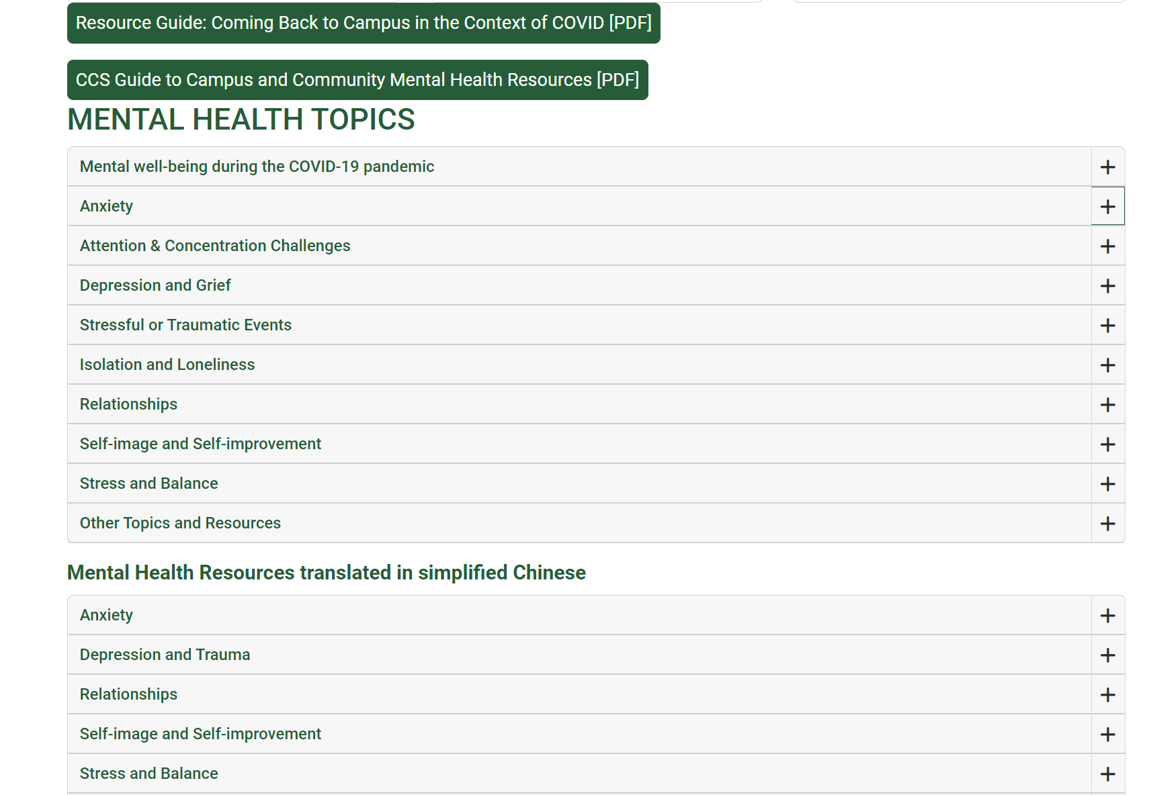

Slide 12
Thanks!
Any other concerns?
2023/24 BDA

Slide 13
Walking Tour!

